Slide 1
Sickle Cell Disease
Dr. Ali Khazaal Jumaa
F.I.B.M.S (Int. Medicine), F.I.B.M.S (Hematology)

Slide 2
What is SCD ?
Sickle cell diseases (SCD) are inherited chronic hemolytic anemia resulting from the presence of a mutated form of hemoglobin, hemoglobin S (HbS), with a single nucleotide change in the β-globin gene leading to substitution of valine for glutamic acid at position 6 of the β-globin chain.
The homozygous state (HbSS or sickle cell anaemia) is the most common form of sickle cell disease, but interaction of HbS with thalassemia and certain variant hemoglobins also leads to sickling. The term ‘sickle cell disease’ is used to denote all entities associated with sickling of hemoglobin within RBC.

Slide 3
Different subtypes of Sickle Cell Diseases

Slide 4
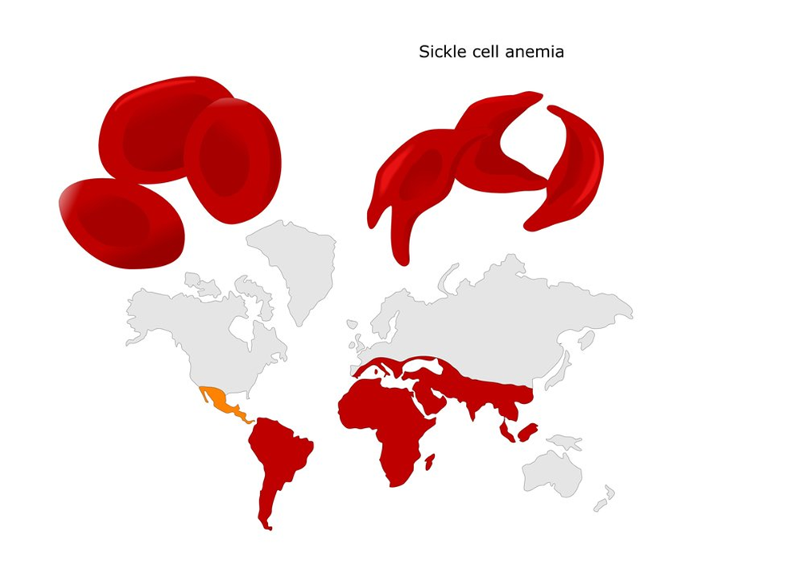
Epidemiology
- The disease is most frequently found in Africa, it is also found in some parts of middle east, South America, Greece, Italy, India and southeast Asia.

Slide 5
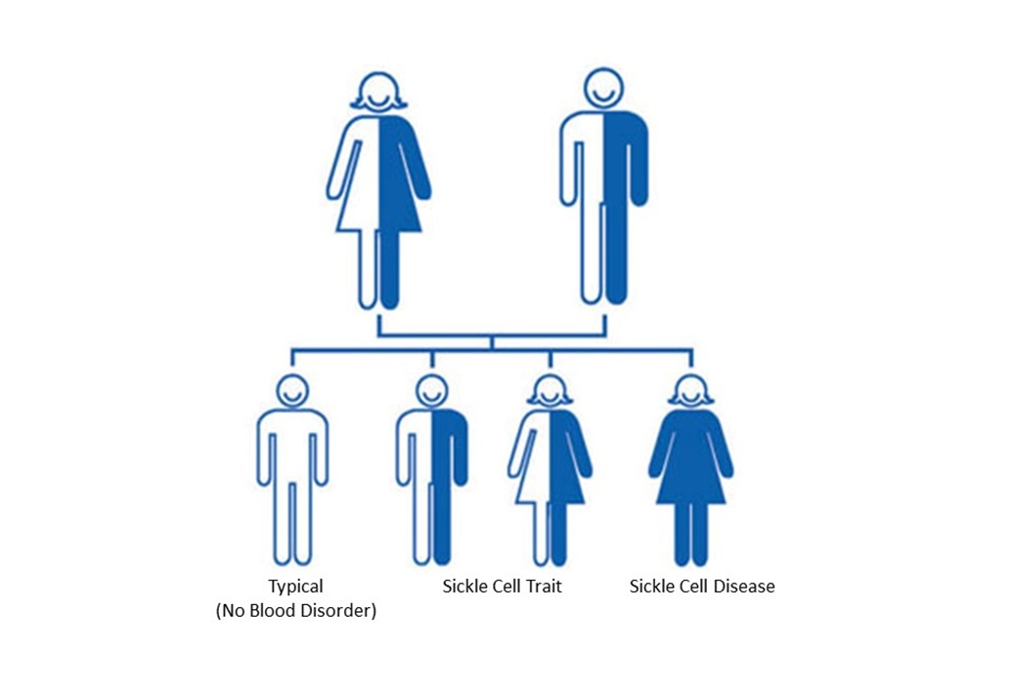
Genetics
- Sickle cell conditions have an autosomal recessive pattern of inheritance from parents.
- The allele responsible for sickle cell anemia can be found on the short arm of chromosome 11

Slide 6
Pathophysiology
- Under deoxy conditions, HbS undergoes marked decrease in solubility, increased viscosity, and polymer formation.
- RBCs acquire the sickle or elongated shape upon deoxygenation as a result of intracellular polymerization of HbS, a phenomenon that is reversible on reoxygenation.
- The presence of HbS polymer reduces deformability, with consequent increase in blood viscosity.

Slide 7
Pathophysiology
- Repeated or prolonged sickling progressively damages RBC membrane, which cause movement of potassium ions and water out of the cell, leading to dehydration of red cells.
- A second key consequence of membrane damage is alteration of the chemistry of the red cell membrane. Perturbation of lipid organization causes negative charges to appear RBC surface.
- RBCs become abnormally adherent to the vascular endothelium through vascular cell adhesion molecule, thrombospondin and fibronectin.

Slide 8
Vaso-occlusion
Several processes contribute to development of vaso-occlusion in SCD:
- Slowing of blood flow arises from abnormal regulation of vascular tone as a result of diminished nitric oxide (NO)-induced vasodilatation.
- This is aggravated by increase in blood viscosity, resulting from less deformable red cells.
Vaso-occlusion is initiated by adhesion of red cells to the vascular endothelium, and is promoted by leukocytosis, platelet activation and inflammatory cytokines.

Slide 9
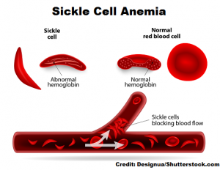

Slide 10
Hemolysis
- SCD is characterized by chronic intravascular and extravascular hemolysis. Sickling-induced membrane fragmentation and complement-mediated lysis cause intravascular destruction of RBCs. Membrane damage also leads to extravascular hemolysis through entrapment of poorly deformable cells.
- Patients have greatly expanded bone marrow space, but the serum erythropoietin level is lower than expected for the extent of anemia because of the decreased oxygen affinity of HbS.
- The significance of chronic intravascular hemolysis in SCD extends beyond anemia, since the release of free Hb causes depletion of NO in the plasma. This is linked to endothelial dysfunction and the development of several complications, including pulmonary hypertension.

Slide 11
Diagnosis:
1- Baseline Blood Study Abnormalities
Hemoglobin level is 5-9 g/dL
Total leukocyte count is elevated to 12,000-20,000 cells/mm3 (12-20 X 109/L), with a predominance of neutrophils
Platelet count is increased
Erythrocyte sedimentation rate is low
The reticulocyte count is usually elevated

Slide 12
2- Hemoglobin electrophoresis
Hemoglobin electrophoresis differentiates individuals who are homozygous for HbS from those who are heterozygous. It establishes the diagnosis of SCD by demonstrating a single band of HbS (in HbSS) or HbS with another mutant hemoglobin in compound heterozygotes.

Slide 14
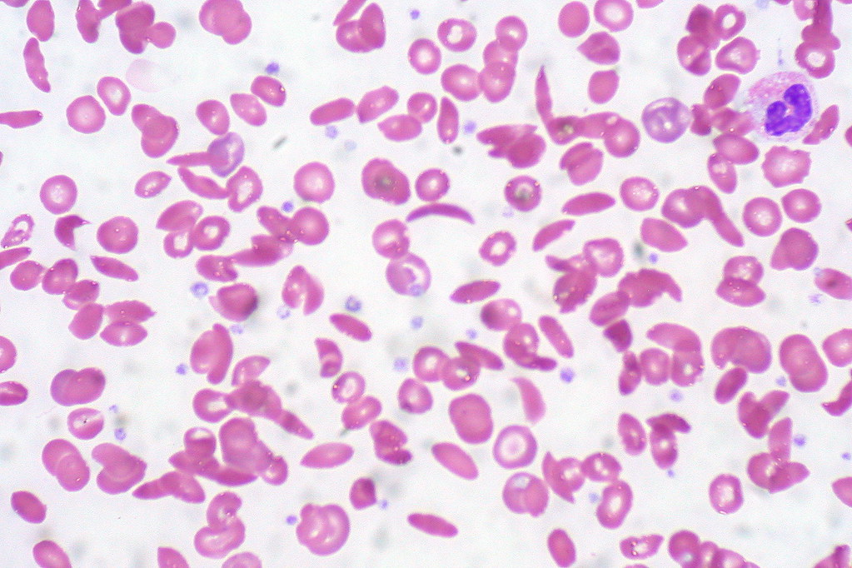
3- Blood film: target cells, elongated cells, and characteristic sickle erythrocytes

Slide 15
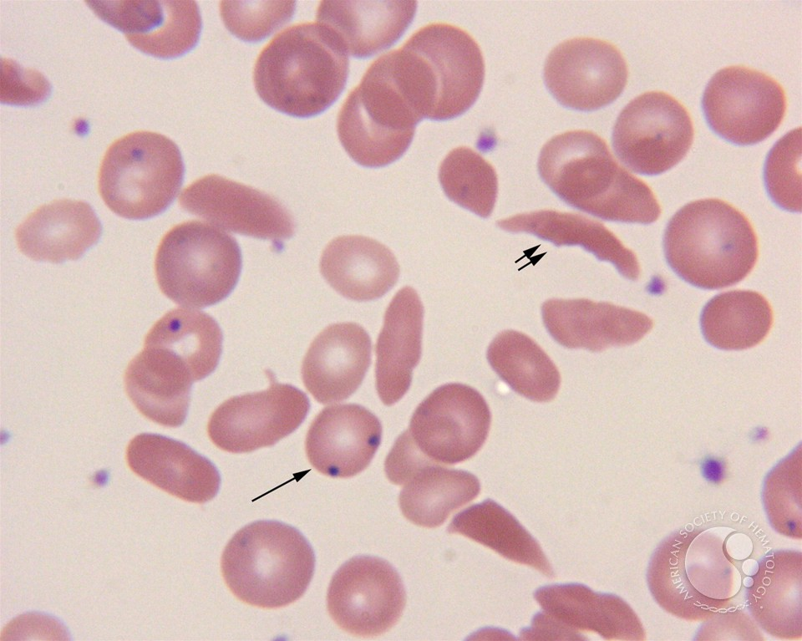
Presence of RBCs containing nuclear remnants (Howell-Jolly bodies) indicates that the patient is asplenic

Slide 16
Clinical manifestations
Clinical symptoms vary between patients with SCD. The disease is more severe in patients with HbSS or HbS/β0-thalassaemia than in those with HbS/β+-thalassemia or HbSC disease.
The coinheritance of one or two α-gene deletions results in lower MCV, MCH, total bilirubin and absolute reticulocyte counts, versus SS pattern.
The high HbF level observed in hereditary persistence of fetal Hb (HPFH) is associated with very mild disease.

Slide 17
Presentation
Sickle cell disease (SCD) usually manifests early in childhood. For the first 6 months of life, infants are protected largely by elevated levels of Hb F; soon thereafter, the condition becomes evident.
Anemia
Vaso-occlusive crisis
Aplastic crisis
Splenic sequestration crisis
Other

Slide 18
Anemia
Causes: - Chronic hemolysis
- Iron deficiency: due to intravascular hemolysis and
subsequent hemoglobinuria
- Folate deficiency: due to increased cell turnover
- Inadequate erythropoietin production due to chronic
renal insufficiency
- Acute anemia exacerbation : aplastic crisis
splenic sequestration

Slide 19
Vaso-occlusive crisis (painful crisis)
It is the most common clinical manifestation of SCD.
A vaso-occlusive crisis occurs when the microcirculation is obstructed by sickled RBCs, causing ischemic injury to the organ supplied and resultant pain.
Pain crises constitute the most distinguishing clinical feature of sickle cell disease and are the leading cause of emergency department visits and hospitalizations for affected patients.

Slide 20
Vaso-occlusive crisis
The pain can affect any body part. It often involves the bones, joints and soft tissue, and it may present as dactylitis (bilateral painful and swollen hands and/or feet in children), acute joint necrosis or avascular necrosis, or acute abdomen.
With repeated episodes in the spleen, infarctions and autosplenectomy predisposing to life-threatening infection are usual.
The liver also may infarct and progress to liver failure with time.
Papillary necrosis is a common renal manifestation of vaso-occlusion, leading to isosthenuria (i.e., inability to concentrate urine).

Slide 21
Vaco-occlusive crisis
Severe deep pain is present in the extremities, involving long bones. Abdominal pain can be severe, resembling acute abdomen; it may result from referred pain from other sites or intra-abdominal solid organ or soft tissue infarction. Reactive ileus leads to intestinal distention and pain.
Pain may be accompanied by fever, malaise, and leukocytosis.

Slide 22
Triggers of vaso-occlusive crisis
Often, no precipitating cause can be identified.
The most likely physiologic trigger of vaso-occlusive crises is hypoxemia. This may be due to acute chest syndrome or accompany respiratory complications.
Dehydration can precipitate pain due to hemoconcentration.
Acidosis results in a shift of the oxygen dissociation curve, causing hemoglobin to desaturate more readily.
Changes in body temperature.

Slide 23
Aplastic crisis
A serious complication is the aplastic crisis. This is caused by infection with Parvovirus B-19. This virus causes fifth disease, a normally benign childhood disorder associated with fever, malaise, and a mild rash. This virus infects RBC progenitors in bone marrow, resulting in impaired cell division for a few days. In people with SCD, the RBC lifespan is greatly shortened (usually 10-20 days), and a very rapid drop in Hb and reticulocyte count occur.
The condition is self-limited, needs transfusion support, with bone marrow recovery occurring in 7-10 days, followed by brisk reticulocytosis.

Slide 24
Splenic sequestration crisis
Splenic sequestration occurs with highest frequency during the first 5 years of life in children with SCA. This complication is characterized by the onset of life-threatening anemia with rapid enlargement of the spleen and high reticulocyte count.
Splenic sequestration is a medical emergency that demands prompt and appropriate treatment. Treatment of the acute episode requires early recognition, careful monitoring, and aggressive transfusion support. Because these episodes tend to recur, many advocate long-term transfusion in young children and splenectomy in older children.

Slide 25
Infection
Functional asplenia results in extreme susceptibility to infection.
Organisms that pose the greatest danger include encapsulated respiratory bacteria, particularly Streptococcus pneumoniae.
Consider osteomyelitis when dealing with a combination of persistent pain and fever. Bone that is involved with infarct-related vaso-occlusive pain is prone to infection. Staphylococcus and Salmonella are the 2 most likely organisms responsible for osteomyelitis.
During adult life, infections with gram-negative organisms, especially Salmonella, predominate.

Slide 26
Effects on growth and maturation
During childhood and adolescence, SCD is associated with growth retardation, delayed sexual maturation, and being underweight.
Affected pubertal males were shorter and had significantly slower height growth than their unaffected counterparts, with a decline in height over time.
In addition, the mean fat free mass increments in affected males and females were significantly less than those of the control children.
Delays also occur onset of puberty, and female patients achieve menarche
1–2 years later than their peers.

Slide 27
Acute chest syndrome
The acute chest syndrome consists of chest pain, fever, cough, tachypnea, leukocytosis, and pulmonary infiltrates.
It is a medical emergency and must be treated immediately. Patients are otherwise at risk for developing acute respiratory distress syndrome.
Acute chest syndrome probably begins with infarction of ribs, leading to chest splinting and atelectasis.
In children, acute chest syndrome is usually due to infection. Other etiologies include pulmonary infarction and fat embolism resulting from bone marrow infarction.
Higher Hb is a risk factor.

Slide 28
Central nervous system involvement
CNS involvement is one of the most devastating aspects of SCD. The most severe manifestation is stroke, resulting in varying degrees of neurological deficit. Stroke is usually ischemic in children and hemorrhagic in adults.
Children with sickle cell disease may have various anatomic and physiologic abnormalities that involve the CNS even if they appear to be neurologically healthy. These silent brain infarcts occur in 17% of patients and may be associated with deterioration in cognitive function, with effects on learning and behavior.
Lower Hb is a risk factor.

Slide 29
Cardiac involvement
The heart is involved due to chronic anemia and microinfarcts. Hemolysis and blood transfusion lead to hemosiderin deposition in the myocardium.
Cholelithiasis
Cholelithiasis is common in pt with SCD, as chronic hemolysis with hyperbilirubinemia is associated with the formation of bile stones. Cholelithiasis may be asymptomatic or result in acute cholecystitis, requiring surgical intervention.

Slide 30
Renal involvement
Due to recurrent papillary necrosis, the kidneys lose concentrating capacity; Isosthenuria, which results in a large loss of water, further contributing to dehydration in these patients. Renal failure may ensue, usually preceded by proteinuria.
Eye involvement
Paraorbital facial infarction may result in ptosis. Retinal vascular changes also occur. A proliferative retinitis is common in Hb SC disease and may lead to loss of vision.
Leg ulcers
Leg ulcers are a chronic painful problem. They result from minor injury to the area around the malleoli. Because of relatively poor circulation, compounded by sickling and microinfarcts, healing is delayed and infection becomes established.

Slide 31
Priapism
a sustained, painful, and unwanted erection, is a well-recognized complication of SCD. It is caused by vaso-occlusion leading to obstruction of venous drainage.
Prolonged priapism, more than 3 hours, is an emergency that requires urologic consultation. Recurrent episodes of priapism can result in fibrosis and impotence, even when adequate treatment is attempted.

Slide 32
Avascular necrosis
Vascular occlusion can result in avascular necrosis (AVN) of the femoral or humeral head and subsequent infarction and collapse at either site. AVN of the femoral head presents a greater problem because of weight bearing. Untreated advanced cases may end with progressive flattening and collapse of the femoral head, resulting in painful secondary degenerative arthritis.

Slide 33
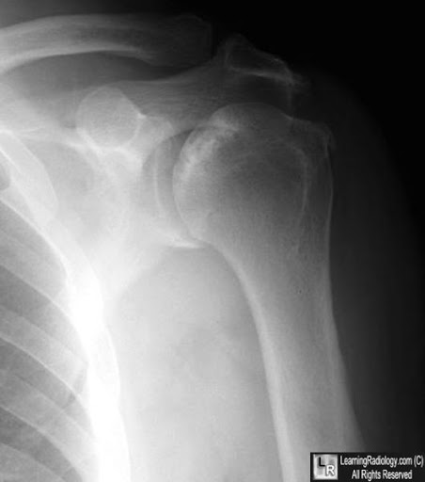
Avascular necrosis

Slide 34
Pulmonary hypertension
It is a serious complication of sickle cell disease, with an incidence as high as 30%. Intravascular hemolysis, with subsequent depletion of nitric oxide ; a vasodilator compound, chronic hypoxia, and recurrent thromboembolism are contributing factors.
Pulmonary hypertension is characterized by a regurgitant tricuspid jet velocity of more than 2.5 m/s by echocardiography.
The diagnostic test is right heart catheterization.

Slide 35
Treatment
The goals of treatment are symptom control and management of disease complications. Treatment strategies include the following seven goals:
1- Management of vaso-occlusive crisis
2- Management of chronic pain syndromes
3- Management of chronic hemolytic anemia with subsequent iron
overload
4- Prevention and treatment of infections
5- Management of the complications and the various organ damage
syndromes associated with the disease
6- Prevention of stroke
7- Detection and treatment of pulmonary hypertension

Slide 36
Other recommendations include the following:
- Regular use of folic acid
- Use of daily oral prophylactic penicillin up to age 5
- Annual transcranial Doppler examinations between the ages of 2 and 16 years
- Long-term transfusion therapy to prevent stroke in children with abnormal transcranial Doppler velocity (≥200 cm/s)
- Preoperative transfusion therapy should be used to increase hemoglobin levels to 10 g/dL
- Rapid initiation of opioids for the treatment of severe pain associated with a vaso-occlusive crisis
- Use of analgesics and physical therapy for the treatment of avascular necrosis

Slide 37
Treatment of complications:
Vaso-occlusive crisis
- Good hydration
- Analgesia : NSAID, narcotics
- O2
- Antibiotics
- Exchange transfusion (refractory cases)

Slide 38
Splenic sequestration crisis
- PRBC transfusion
- I.V fluid
- Analgesia
- Exchange transfusion
- splenectomy: after resolution of acute crisis to prevent recurrence
Acute chest syndrome
- I.V fluid
- O2, respiratory support
- Antibiotic
- Exchange transfusion
- Bronchodilators and corticosteroid

Slide 39
Priapism
- Good hydration
- Opioid analgesia
- An oral dose of pseudoephedrine or terbutaline can be given.
- If priapism persists for more than 2–3 hours, aspiration and irrigation of the corpora with dilute phenylephrine solution should be performed.
- Sildanefil has been proposed as a therapeutic agent for the prevention of recurrent ischaemic priapism.

Slide 40
Hydroxycarbamide (hydroxyurea)
Hydroxycarbamide inhibits ribonucleotide reductase, leading to S-phase arrest of replicating cells, and is used in SCD because of its ability to stimulate production of HbF.
RBC of patients on hydroxycarbamide have increased water content and deformability and decreased adherence to vascular endothelium.
There is decrease in WBC, reticulocyte and platelet counts.

Slide 41
Indications in SCD:
Frequent painful episodes
History of acute chest syndrome
History of other severe vaso-occlusive events
Severe symptomatic anemia
History of stroke

Slide 42
Exchange transfusion
The indications for exchange transfusion include:
acute stroke
acute chest syndrome
refractory vaso-occlusive crisis
acute severe priapism.

Slide 43
Novel therapies
- L-glutamine oral powder (Endari) to reduce severe complications of SCD by reducing oxidative stress, which contributes to the pathophysiology of SCD.
- Crizanlizumab, a P-selectin inhibitor, was approved to reduce the frequency of vaso-occlusive crisis in adults with SCD. Binding P-selectin on the surface of activated endothelium and platelet cells blocks interactions between endothelial cells, platelets, red blood cells (RBCs), and leukocytes.
- Voxelotor is indicated for treatment of SCD in adults and adolescents aged 12 years or older. Voxelotor is a hemoglobin S (HbS) polymerization inhibitor.

Slide 44
- Allogeneic bone marrow transplantation (BMT) can cure SCD, but it is difficult to decide which patients should be offered BMT. Many risks are associated with BMT, and the risk-to-benefit ratio must be assessed carefully.
- Gene therapy is emerging as a possible cure for severe SCD. Successful results in individual patients has been reported, and clinical trials are planned or in progress.

Slide 45
Genetic counselling
TREATMENT vs PREVENTION
vs

Slide 46
Other SCDs

Slide 47
Sickle cell trait
Sickle cell trait (HbAS) is a benign condition that has no or mild hematological manifestations. Sickling and vaso-occlusion under extreme circumstances can lead to painful episodes. Genetic counselling should be provided to individuals with sickle cell trait.
HbSC disease
The vaso-occlusive complications seen in patients with HbSC resemble those seen in patients with HbSS, but are less severe. Splenomegaly and the risk of sequestration can persist into adult life. The hemoglobin level is higher than in HbSS, and the red cells are relatively microcytic.

Slide 48
Sickle cell/𝛃-thalassemia
It accounts for less than 10% of patients with sickle syndromes. The majority of these patients have the HbS/β+-phenotype, with the proportion of HbA ranging from 3 to 25%. The clinical phenotype is mild and disease severity correlates with the amount of HbA present. The clinical manifestations of HbS/β0-genotype are similar in severity to those of HbSS. The red cells are microcytic and hypochromic, and variable numbers of target cells and sickle cells are observed. The level of HbA2 is elevated.
Sickle cell anemia with coexistent 𝛂-thalassemia
Coinheritance of α-thalassemia with SCD is common, and such patients have less severe anemia and demonstrate hypochromia and microcytosis.

Slide 49
Sickle cell/HPFH (hereditary persistent HBF)
Approximately 1 in 100 patients with HbSS has an elevated HbF level due to deletional or non-deletional mutations that maintain γ-globin gene expression after birth. Such individuals have 20–30% HbF.
The clinical course is benign, and Vaso-occlusive complications are rare because of the inhibition of sickling by elevated HbF.

Slide 50
Sickle cell/Hb Lepore disease
Coinheritance of Hb Lepore with sickle cell mutation produces a clinical picture similar to that of HbS/β-thalassemia, but with a lowHbA2 level.
Sickle cell/HbO Arab disease
It is a moderately severe hemolytic anemia.
Sickle cell/HbE disease
It causes mild hemolysis and no remarkable abnormality
of red blood cell.

